Slide 1

CMR COLLEGE OF ENGINEERING & TECHNOLOGY
Kandlakoya, Medchal, Hyderabad - 501401
Department of Computer Science and Engineering
SAP SuccessFactors – Performance Appraisal Management System
Name of the students
Yoddi Sandeep - 20H51A0527
Sreya Srungarapu - 20H51A0550
Guduru Sai Bhargav - 20H51A05K6
Under esteemed guidance of
Ms Princy (Assistant Professor)

Slide 2
Outline
Abstract.
Introduction.
Literature Survey.
Existing System
Problems in existing Systems.
Research Objective of Presentation.
Problem Definition.
Research Work.
Proposed System Architecture.
Proposed Methods.
Comparison of Proposed system to existing system.
Performance Measure
Results
Conclusion
Future Work

Slide 3
Abstract
Performance appraisal is a vital tool to measure the frameworks set by any organization to its employees. It is utilized to track individual contribution and performance against organizational goals and to identify individual strengths and opportunities for future improvements and assessed whether organizational goals are achieved or serves as basis for the company’s future planning and development.

Slide 4

Introduction
The success of any organization depends on the quality and characteristics of its employees
The employees become a significant factor in any organization since they are the heart of the company. Organizations simply cannot achieve their goals and objectives without them.

Slide 5
Research Objective.
To diagnose the strengths and weaknesses of the individuals so as to identify the training and development needs of the future.
To provide feedback to the employees regarding their past performance.
Provide information to assist in the other personal decisions in the organization.
To judge the effectiveness of the other human resource functions of the organization such as recruitment, selection, training and development.
To reduce the grievances of the employees.

Slide 6
Problem Definition
SAP SuccessFactors Performance Appraisal Management System can help you align your strategy and goals, improve employee performance through ongoing coaching and feedback, and recognize top talent.

Slide 7
Project Scope and Limitations
Scope:
The overall scopes of objective of performance appraisal is to improve the efficiency of an enterprise by attempting to mobilize the best possible efforts from individuals employed in it. Such appraisals achieve four objectives including
Salary reviews
Development and training of individuals
Planning job rotation and assisting in promotions.
Limitations:
This is just a single module in the SuccessFactors field, so it does not have the access to other modules like Compensation Module that supports the annual salary review and bonus calculations based on achievement of business goals and/or individual goals without distributing data outside SuccessFactors.

Slide 8
Literature Review
Comparison table for the existing system
S.No | Authors and Journal Name | Problem Statement | Name of the Proposed solution/Method | Solution | Remarks
1 | SAP Success factors | PMGM | Performance Appraisal Process | track individual contribution and performance over organizational goals | identify individual strengths and opportunities for future improvements
2 | Sebastian Rothmann | PMGM | Performance Appraisal on Perceived Supervisor Support | focuses on identifying, appreciating future development of employee strengths | motivate employees toward higher levels of performance
3 | Mukesh Kumar,Dr. N Shirley | Employee’s PMGM | Employee’s Performance Appraisal System | 360 degrees appraisal method whereby superiors and the appraise their subordinates | effective performance appraisal strategy

Slide 9
Implementation of Existing System
Free Form Method: The traditional form of appraisal, also known as “Free Form method” involves a description of the performance of an employee by his superior.
Merits:
Rich and Detailed Feedback
Flexibility and Adaptability
Demerits:
Lack of Standardization
Subjectivity and Biasness

Slide 10
Implementation of Existing System
HCM Solutions: The performance management module in Oracle HCM is commonly referred to as "Oracle Performance Management" or "Oracle Talent Management."
Merits:
Scalability
Configurability
Demerits:
Complex Implementation
Cost

Slide 11
Implementation of Existing System
OKR Methodology: OKR (Objectives and Key Results) is a goal-setting framework used by organizations to define and track objectives and their outcomes.
Merits:
Scalability
Configurability
Demerits:
Complex Implementation
Cost

Slide 12
Proposed Method
SAP SuccessFactors Performance and Goals is a bundle of applications, part of the SAP SuccessFactors HXM integrated suite of solution. The applications are used to develop and manage organization’s employees through automation of talent management. With SAP SuccessFactors Performance management and Goal management, an organization can increase efficiencies and continuously manage the performance of employees.
It can help align strategy and goals, capture more balanced and accurate performance assessments, improve employee performance through ongoing coaching and feedback, and recognize top talent.

Slide 13
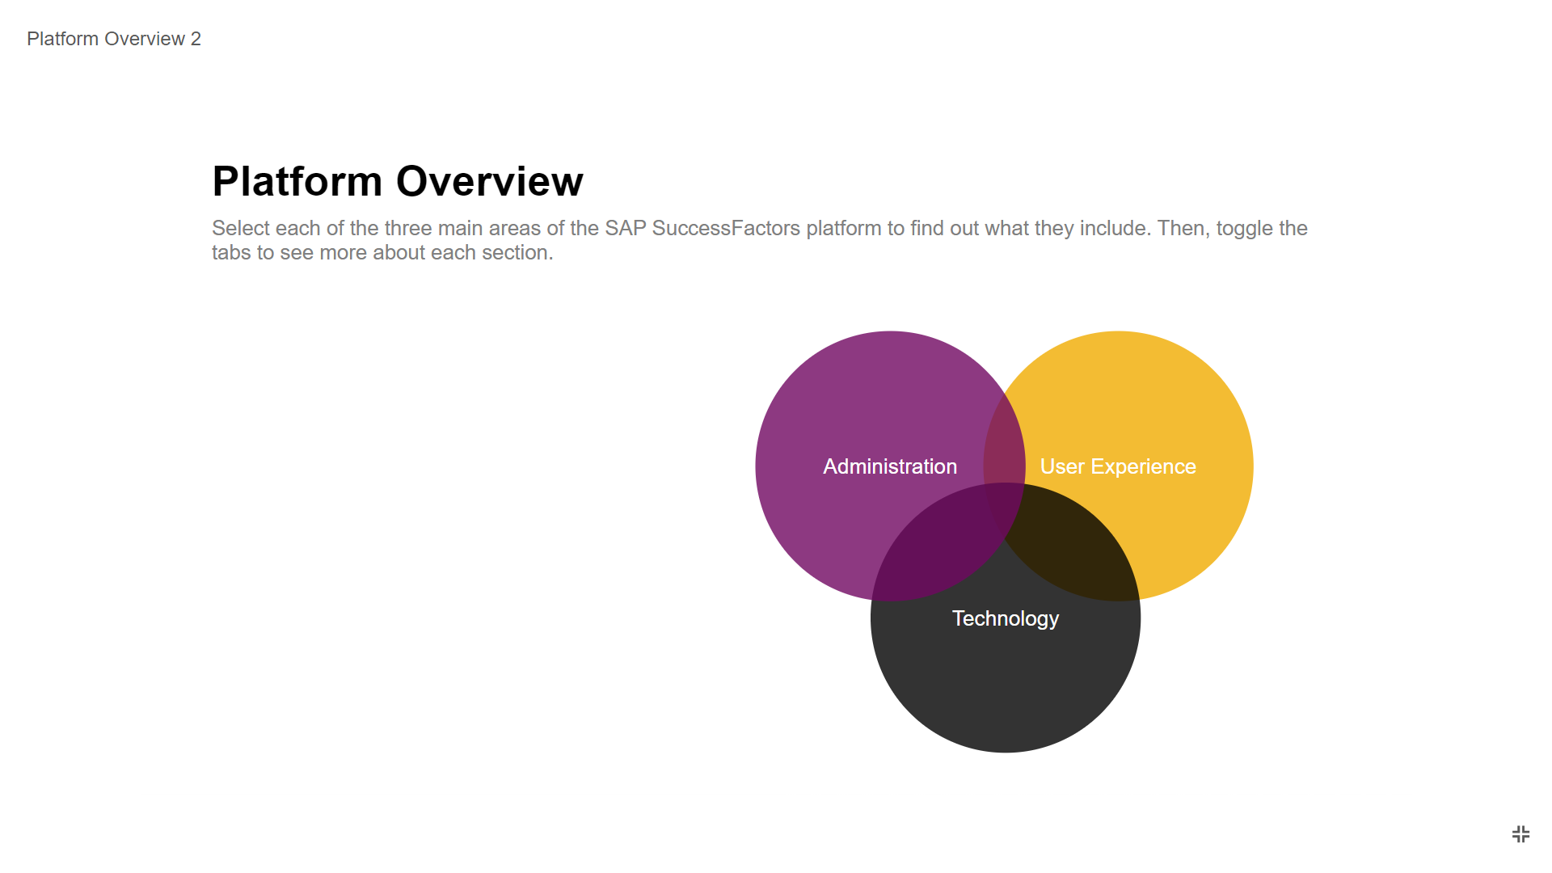
Platform Overview
There are three main areas of SAP SF platform.
Administration – undergoes following functionalities.
Security
Monitoring
Upgrade Management
2. User Experience – undergoes functionalities of user interface.
3. Technology – undergoes following functions.
Data Protection and Privacy
Integrated Services
Metadata Framework
People Analytics

Slide 14
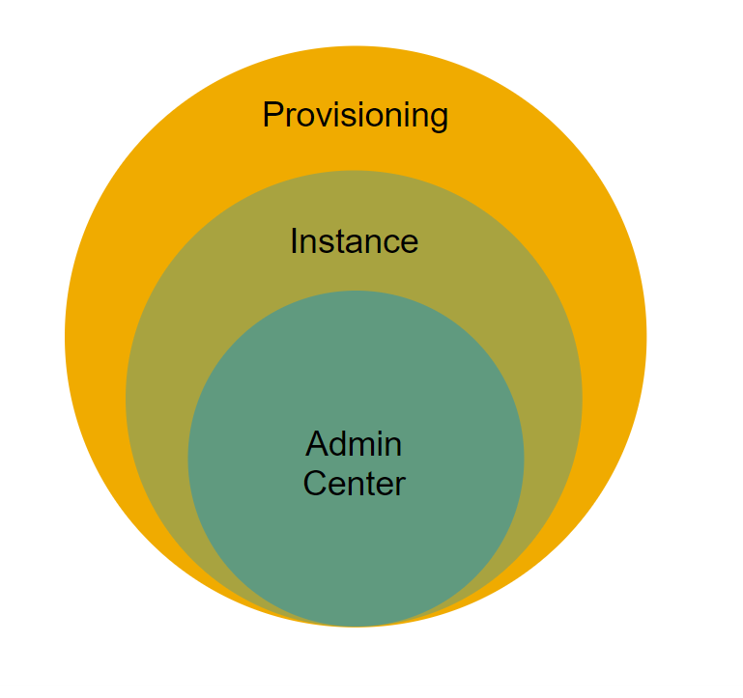
Interaction with SAP SF Platform
Provisioning: Key configuration tool that SAP SF use to control many aspects of the customer instance. It is the “backend” of system. Customers do not have access to provisioning.
Instance: Front-end, or customer-facing view of SAP SF platform. Consultants, admins and users see the same interface.
Admin Center: Available to implementers and administrators.

Slide 15
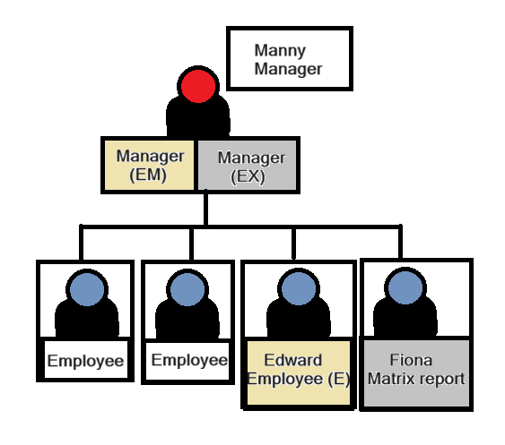
Role Management Architecture
1.Employee view (E):
Can look at his own goal plan
Add Goals, see all goal fields, Edit goals, See private goals.
2. Manager (EM):
Accesses Direct Report of Edward goal plan.
Cannot see Edward's private goals.
3. Employee Direct Report (ED):
Accesses his manager's Goal plan.
Limited to see two goal fields.
Cannot view private goals & cannot add edit goals.
4. Matrix Manager (EX):
Many accesses Fiona's goal plan.
Cannot edit add goals nor can he see her private goals.

Slide 16
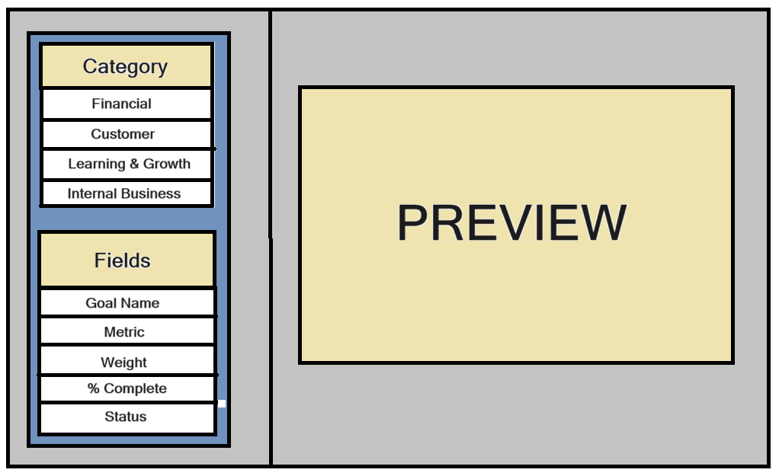
Goal Template Architecture
Components of Goal Management:
Categories: Organization can opt for a basic goal plan containing one category (or) extended goal with multiple categories.
Types: Customer, financial, learning and growth internal business process.
Fields: Goals are defined by fields. Employees can track their progress & update goal fields.
Ex: Goal Name, Metric, Weight, % Complete, Status.

Slide 17
Performance Template Architecture
1. Employee self evaluation:
Consider an employee Brooke’s end of year performance review begins with a self-evaluation step. Brooke can provide ratings and comments if applicable.
2. Manager review:
Brooke’s manager (Manny) receives Brooke’s self evaluation, reviews it and then the manager conducts their own evaluation of Brooke’s performance on goals and competencies.
3. 1:1 Meeting:
Brooke and Manny need to discuss the evaluation. This includes reviewing and giving feedback on Brooke’s performance. Brooke can review the summary of ratings received from Manny manager.
4. Employee signature:
The form is sent to Brooke for electronic signature.

Slide 18
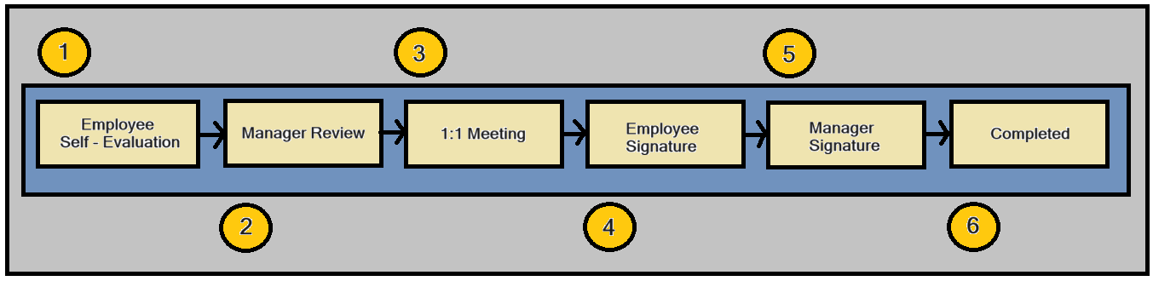
Performance Template Architecture
5. Manager signature:
The form is sent to Manny for electronic signature. Once Manny signs, the form is considered complete.
6. Completed:
A completed review form remains in the completed folder of the performance module. No more changes can be made to the form.

Slide 19
Result
The platform's strength lies in its ability to align individual goals with broader organizational objectives, fostering a culture of continuous improvement through ongoing feedback and development planning. SuccessFactors also supports talent calibration and succession readiness, contributing to strategic workforce planning and leadership development.

Slide 20
Conclusion
In conclusion, SAP SuccessFactors provides a comprehensive Performance and Goal Management system equipped with a diverse set of performance metrics aimed at evaluating individual and organizational success. These metrics, ranging from goal achievement and competency assessment to feedback participation and employee engagement scores, offer organizations valuable insights into their workforce dynamics.

Slide 21
Thank You.

